Slide 1
TITLE : Weather Application – SkyCast
DEVELOPED BY : Ayush Lingayat , Shruti Kulkarni & Akshita Warade
GUIDED BY : Ms .Deepali Khedkar
INSTITUTE NAME : Institute of Management Studies and Information Technology
PRINCIPAL : Mr. Ashok Gaikwad

Slide 2
ABSTRACT
This weather website abstract describes a comprehensive online platform designed to provide users with up-to-date and accurate weather information.
The website offers a user-friendly interface with intuitive navigation. The weather website delivers precise and reliable weather predictions for locations within the states of India.
Additionally the website offers customizable features allowing users to personalize their weather experience based on their preferences and interests.

Slide 3
INTRODUCTION
Our Project is usually Weather Application website where you can access the weather information just by simply typing the state in the search box .
You can get the Temperature , Humidity and Wind Information of the particular state in seconds using a Weather Application Website.
Our Weather Application Website offers a user-friendly Interface so that it is easy and more interactive to user.
We have build a good looking navigation bar which will attract the user using the website. Lastly this website is build using teamwork and all the credit goes to respective teammates under the guidance of Deepali Khedkar Mam

Slide 4
OBJECTIVES
Real Time Updates : Provide users with real time weather updates to ensure they have the latest information about current weather conditions
Accurate Forecasts : Deliver accurate weather forcast for different time frames to help user plan their activities and make informed decisions
User Friendly Interface : The User Interface is so good that it attracts user information
Comprehensive Coverage : Cover a wide range of geographical areas , including both urban and rural areas to cater to diverse user needs and location

Slide 5
SYSTEM SPECIFICATION
HARDWARE REQUIREMENTS :
Device Name : LAPTOP-G599FV6D
Processor used : AMD Ryzen 5 5600H with Radeon Graphics 3.30 GHz
Installed RAM : 8GB (7.34 GB usuable)
System Type : 64-bit Opeating System , x64-based processor

Slide 6
SYSTEM SPECIFICATION
SOFTWARE REQUIREMENTS :
Operating system used : Windows 11
Library Used : Bootstrap
Development : HTML , CSS
Language : JavaScript
Version Control : Git and GitHub

Slide 7
SCOPE
The primary scope of weather application is to provide users with accurate and up-to-date weather information.
This includes current conditions such as temperature, humidity and wind speed.
Weather applications typically offer location based forecasting allowing users to view weather conditions and forecasts for their current location or any other specified location.
This feature is essential for travelers, outdoor enthusiasts, and anyone planning activities in different regions.

Slide 8
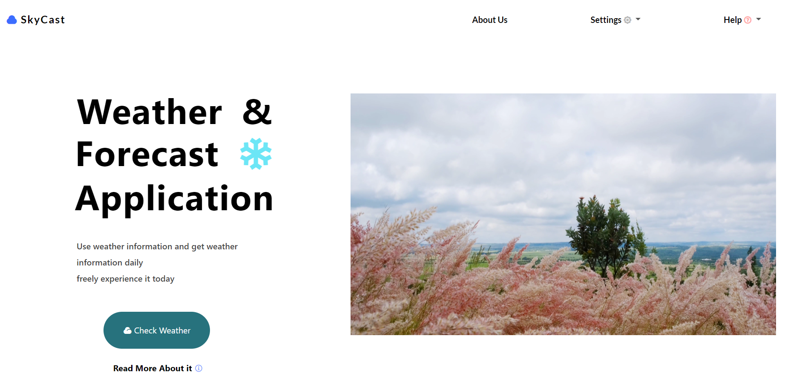
USER INTERFACE

Slide 9
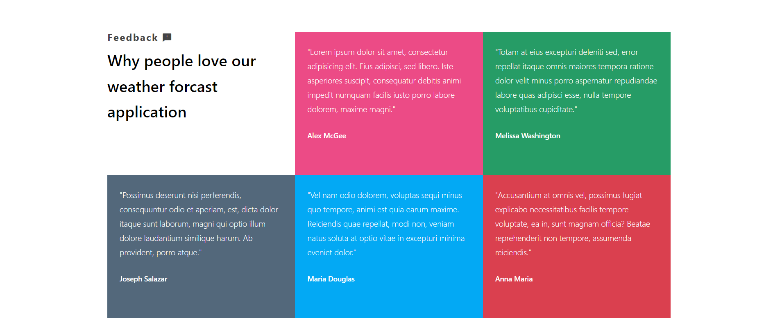

Slide 10
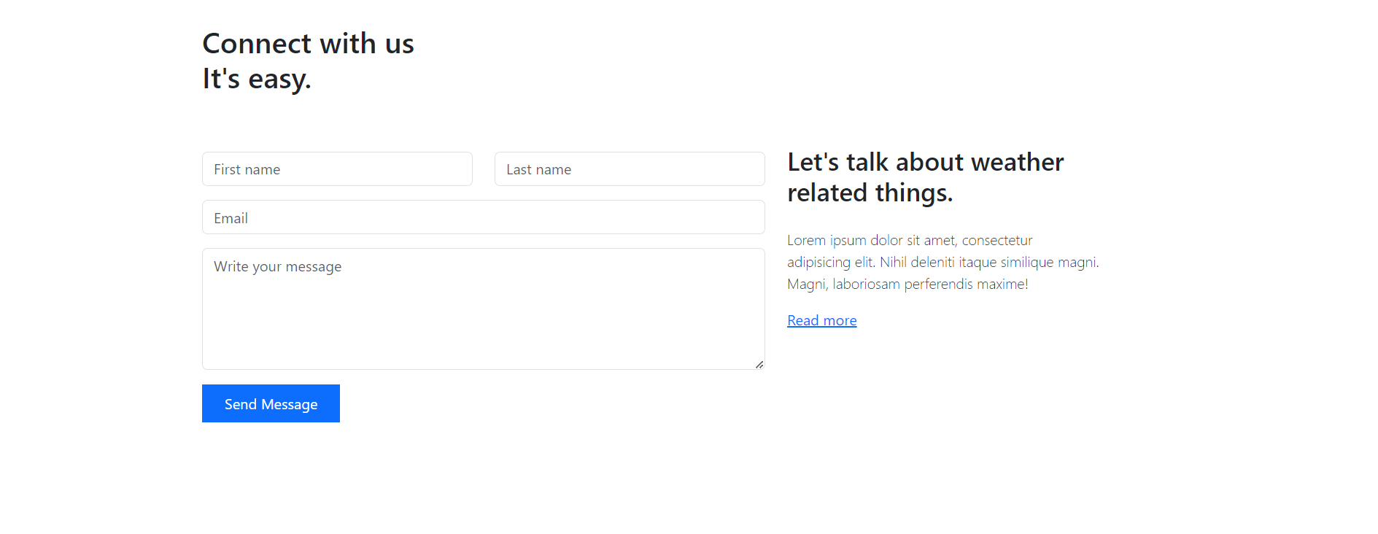

Slide 11
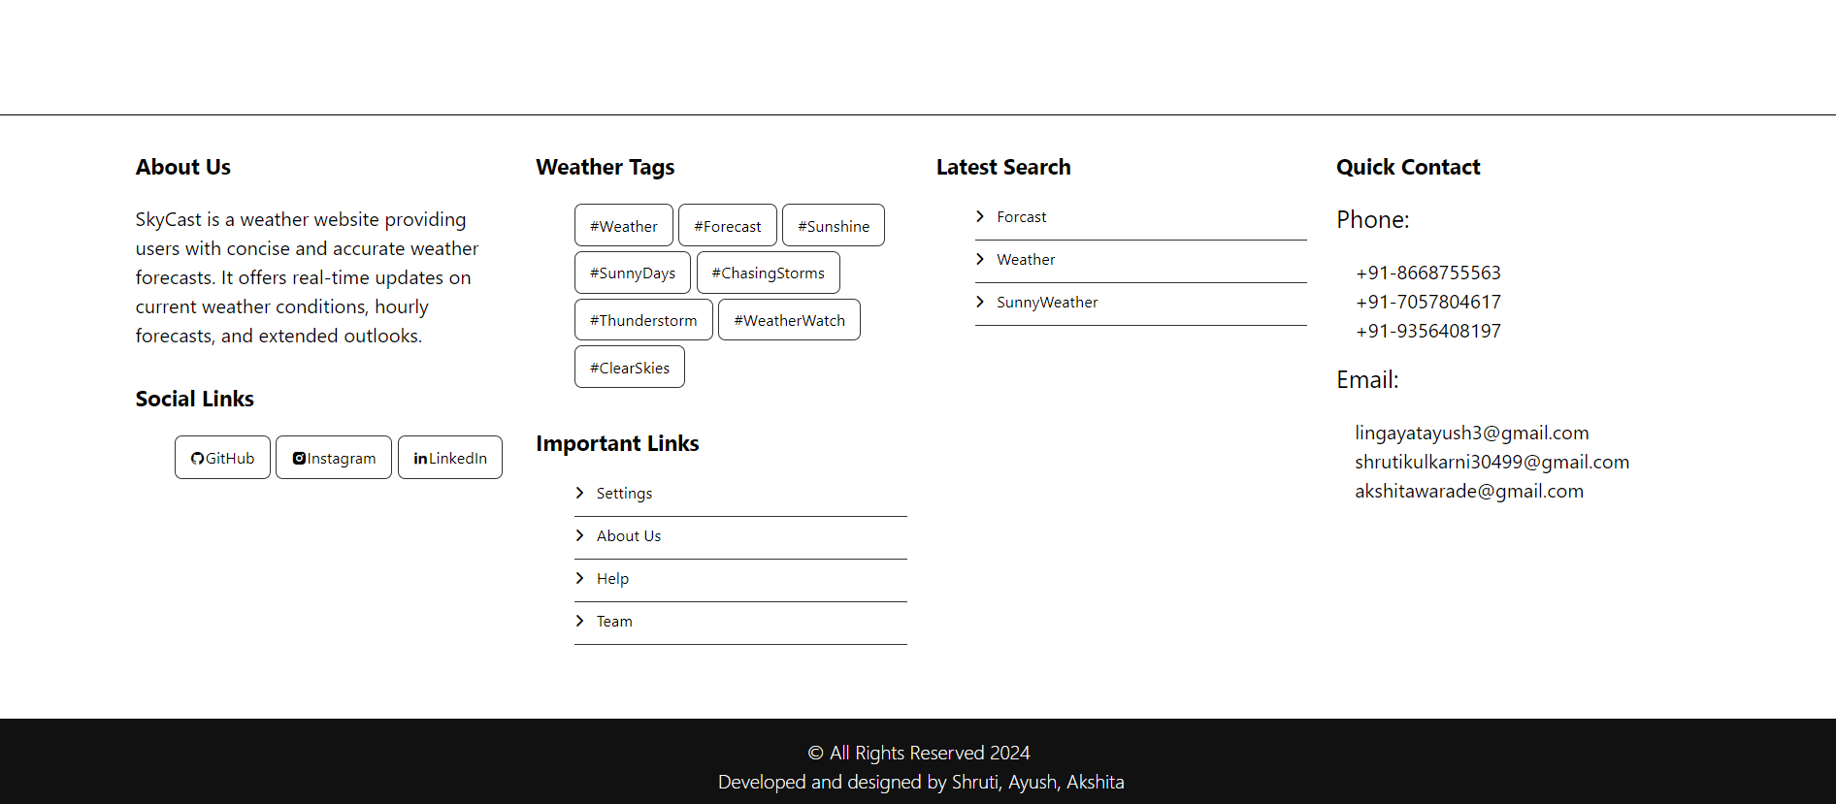

Slide 12
CONCULSION
In conclusion our weather application provides a comprehensive and user-friendly platform for accessing accurate and up-to-date weather information.
With features such as current weather conditions and forecasts the users can plan their activities with confidence and stay informed about changing weather patterns.
The air quality information and customizable options enhances the utility and relevance of the application by prioritizing accuracy and user engagement Our weather application aims to be a trusted resource for individuals, businesses, and communities

